Slide 1
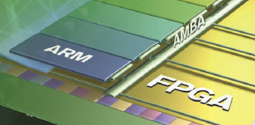

Lecture 14 LED Ping-Pong Game with Polling
References on Timer and Interrupts
Lab #7: LED Ping-Pong Game on Zybo
C code template
David Robinson’s Solution
pong_David_Robinson.h
pong_David_Robinson.c
GPIO Banks and XGPio drivers

Slide 2
ARM Timer References
Xilinx: Zynq-7000 All Programmable SoC, Technical Reference Manual, UG585 (v1.10) February 23, 2015
Altera: SoC FPGA ARM Cortex-A9 MPCore Processor Advance Information Brief, aib-01020, February 2012 Altera Corporation
Altera: Cyclone V Device Handbook, Volume 3: Hard Processor System Technical Reference Manual, November 2012 Altera Corporation
Xilinx Processor IP Library – scutimer v2_0 C:\Xilinx\SDK\2014.4\data\embeddedsw\XilinxProcessorIPLib\drivers\scutimer_v2_0
Altera : Introduction to the ARM® Processor Using Altera Toolchain, Altera Corporation University Program, April 2014

Slide 3
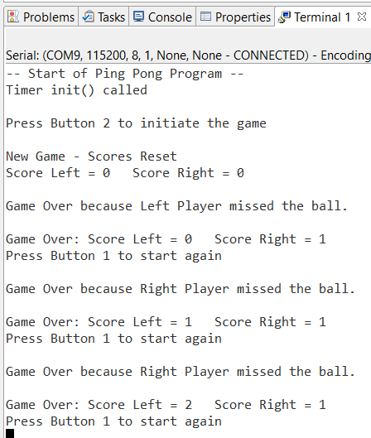
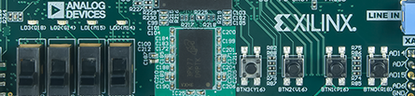
Lab #7: LED Ping Pong Game on Zybo
Reset Button: BTN2
Start Button: BTN1
Left Paddle: BTN3
Right Paddle: BTN0
Left paddle
Right Paddle

Slide 4
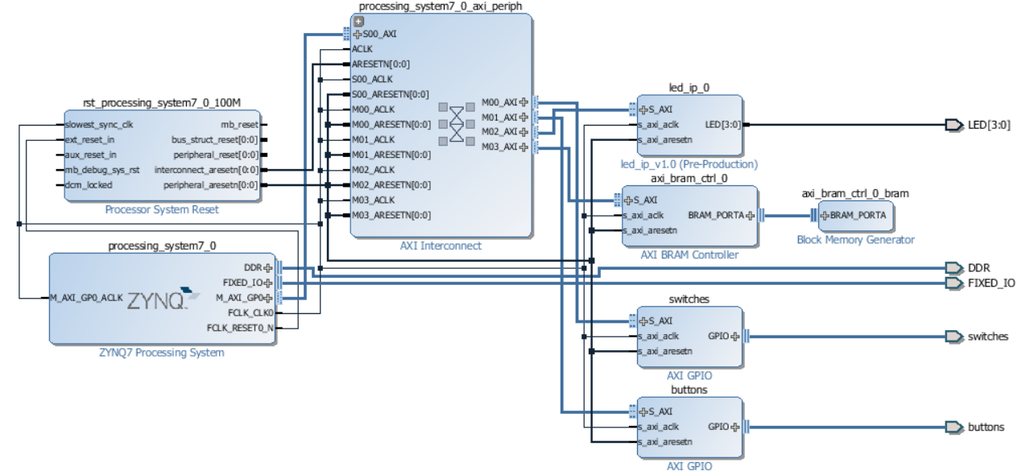
Lab #7: LED Ping Pong Game with Polling on Zybo

Slide 5
Design Philosophy
Always start with a skeleton code
Well structured and self documented code
Self documented variables
No magic numbers or ports
Not about what to do but how to do it
LED3
LED2
LED1
LED0
Left Paddle
Reset
Start
Right Paddle
Ball_Position={0b1000, 0b0100, 0b0010, 0b0001}
Move left
Move right

Slide 6
ASM Chart of Ping-pong Version 1
Start
No
Initialization
Start
Delay
Yes
No
over
Yes
Update Scores
Update Ball
Check Switches
Yes
Game
over
No

Slide 7
ASM Chart of Ping-pong Version 2
Start
No
Initialization
Start
Update Scores
Yes
No
over
Yes
Update Ball
Check Switches
Yes
Game
over
No

Slide 8
Lab #7: LED Ping Pong Game on Zybo: Template (page 1)
#define START 1
#define STOP 0
#define LEFT 0
#define RIGHT 1
#define RESETBUTTON 0b0100
#define STARTBUTTON 0b0010
#define LEFTPADDLE 0b1000
#define RIGHTPADDLE 0b0001
int LED_PATTERNS[4]={0b1000, 0b0100, 0b0010,0b0001};
int scoreright, scoreleft;
char GameOver, StartDirection;
int main (void)
{
unsigned int i;
//initialize variables, timers, ports
xil_printf("-- Start of the Ping Pong Program --\r\n");
GameOver=STOP;
scoreright = 0; scoreleft = 0;
xil_printf("Score Left = %d Score Right = %d\r\n", scoreright, scoreleft);
StartDirection=LEFT;

Slide 9
Lab #7: LED Ping Pong Game on Zybo: Template (page 2)
while (1)
{
// Read push buttons and reset score if Button 2 is pressed
psb_check = XGpio_DiscreteRead(&push, 1);
if(psb_check== RESETBUTTON) //reset game
{
xil_printf("\n\rNew Game - Scores Reset\r\n");
}
if(psb_check == STARTBUTTON) GameOver=START; //start game
//start the game and follow StartDirection}
} //while(1)
} //main()
void MoveBallRight(void) {
char i, EarlyPress;
EarlyPress=0;
//move LED to the right
// check for button pushes
//set StartDirection
//set GameOver; display scores
}

Slide 10
Lab #7: LED Ping Pong Game on Zybo: Template (page 3)
void MoveBallLeft(void) {
char i, EarlyPress;
EarlyPress=0;
//move LED to the left
// check for button pushes
//set StartDirection
//set GameOver, update and display scores
}
void delay(void){
// Read dip switch values
dip_check = XGpio_DiscreteRead(&dip, 1);
// Load timer with delay in multiple of ONE_T
}

Slide 11
David Robinson’s Solution: pong.h (no magic # and port)
#ifndef PONG_H_
#define PONG_H_
#define ONE_TENTH 32500000
#define START_BUTTON_MASK 0x0002
#define RESET_BUTTON_MASK 0x0004
#define BALL_LEFT_START_POSITION 8
#define BALL_RIGHT_START_POSITION 1
#define BALL_START_DIRECTION RIGHT
#define LEFT_PLAYER_NAME "Left Player"
#define LEFT_PLAYER_POSITION 8
#define RIGHT_PLAYER_NAME "Right Player"
#define RIGHT_PLAYER_POSITION 1
#define PLAYER_START_SCORE 0
#define LEDS_OFF 0
#define INPUT 0xffffffff
typedef enum {
LEFT,
RIGHT
} ball_direction;
typedef enum {
NO_RESET,
RESET
} reset;
typedef enum {
MISS,
EARLY,
HIT
} hit_status;
typedef struct {
int speed;
ball_direction direction;
ball_direction serve_direction;
int position;
} ball;
typedef struct {
int score;
int position;
hit_status ;
char name[20];
} player;
#endif /* PONG_H_ */

Slide 12
David Robinson’s Solution: main() in pong.c (less than a page)
int main(void) {
XGpio buttons, switches;
XGpio_Initialize(&buttons, XPAR_BUTTONS_DEVICE_ID);
XGpio_Initialize(&switches, XPAR_SWITCHES_DEVICE_ID);
XGpio_SetDataDirection(&buttons, 1, INPUT);
XGpio_SetDataDirection(&switches, 1, INPUT);
XScuTimer timer;
XScuTimer_Config *timer_config = XScuTimer_LookupConfig(XPAR_PS7_SCUTIMER_0_DEVICE_ID);
int status = XScuTimer_CfgInitialize(&timer, timer_config, XPAR_PS7_SCUTIMER_0_BASEADDR);
if(status != XST_SUCCESS) {
xil_printf("Timer init() failed\r\n");
return XST_FAILURE;
}
while(1) {
play_pong(&buttons, &switches, &timer);
}
return 0;
}
//Lab #6 Pingpong Game with Zybo
//David M. Robinson
//3-25-2016
#include <strings.h>
#include <stdbool.h>
#include "xparameters.h"
#include "xgpio.h"
#include "led_ip.h"
#include "xscutimer.h"
#include "pong.h"

Slide 13
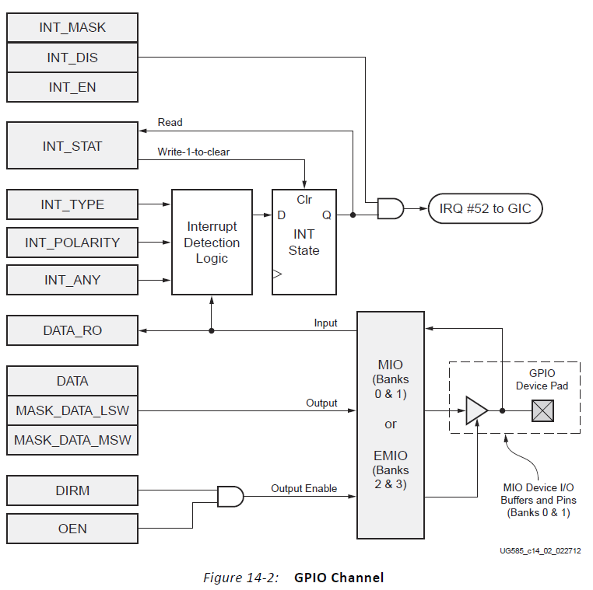
EMIO - Bank 2 and Bank 3 of GPIO: simply wires between PL and PS
The register interface for the EMIO banks is the same as for the MIO banks
However, the EMIO interface is simply wires between the PS and the PL.
The inputs wires from the PL are unrelated the OEN register.
The inputs can be read from the DATA_RO register when DIRM is set to 0, making it an input.
The output wires are not 3-state capable, so they are unaffected by OEN.
The value to be output is programmed using the DATA, MASK_DATA_LSW, and MASK_DATA_MSW registers. DIRM must be set to 1, making it an output.

Slide 14
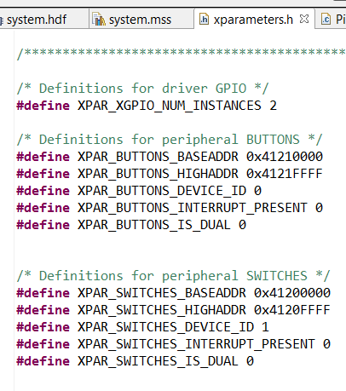
Definition of a XGPio Port: DeviceID, BaseAddress, Channel
typedef in xgpio.h
Xgpio_Config
Xgpio
DeviceID in xparameters.h
BUTTONS
SWITCHES
Channel 1 or 2
typedef struct {
u16 DeviceId; /* Unique ID of device */
u32 BaseAddress; /* Device base address */
int InterruptPresent; /* Are interrupts supported in h/w */
int IsDual; /* Are 2 channels supported in h/w */
} XGpio_Config;
typedef struct {
u32 BaseAddress; /* Device base address */
u32 IsReady; /* Device is initialized and ready */
int InterruptPresent; /* Are interrupts supported in h/w */
int IsDual; /* Are 2 channels supported in h/w */
} XGpio;

Slide 15
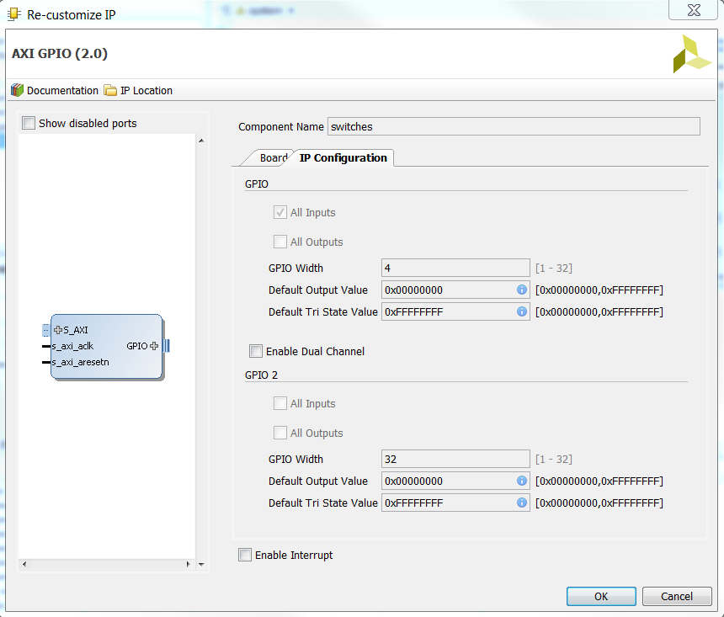
Channel 1 or 2
AXI GPIO has two channels of 32 bits each, GPIO 1 is always enabled
2nd channel, GPIO 2, can be enabled or disabled

Slide 16
xgpio.c: initialization and Level 1 Driver Functions
int XGpio_Initialize(XGpio *InstancePtr, u16 DeviceId);
XGpio_Config *XGpio_LookupConfig(u16 DeviceId);
int XGpio_CfgInitialize(XGpio *InstancePtr, XGpio_Config * Config, u32 EffectiveAddr);
void XGpio_SetDataDirection(XGpio *InstancePtr, unsigned Channel, u32 DirectionMask);
u32 XGpio_GetDataDirection(XGpio *InstancePtr, unsigned Channel);
u32 XGpio_DiscreteRead(XGpio *InstancePtr, unsigned Channel);
void XGpio_DiscreteWrite(XGpio *InstancePtr, unsigned Channel, u32 Mask);

Slide 17
XGpio_Initialize(), XGpio_SetDataDirection(), XGpio_DiscreteRead()
XGpio_Initialize(&dip, XPAR_SWITCHES_DEVICE_ID);
XGpio_SetDataDirection(&dip, 1, 0xffffffff);
psb_check = XGpio_DiscreteRead(&push, 1);

Slide 18
XGpio_Initialize(&dip, XPAR_SWITCHES_DEVICE_ID);
In file xgpio_sinit.c
InstancePtr is a pointer to an XGpio instance
DeviceId is the unique id of the device controlled by this Xgpio instance. Passing in a device id associates the generic Xgpio instance to a specific device, as chosen by the caller or application developer.
int XGpio_Initialize(XGpio * InstancePtr, u16 DeviceId)
{
XGpio_Config *ConfigPtr;
Xil_AssertNonvoid(InstancePtr != NULL);
ConfigPtr = XGpio_LookupConfig(DeviceId);
if (ConfigPtr == (XGpio_Config *) NULL) {
InstancePtr->IsReady = 0;
return (XST_DEVICE_NOT_FOUND); }
return XGpio_CfgInitialize(InstancePtr, ConfigPtr,
ConfigPtr->BaseAddress);
}

Slide 19
XGpio_CfgInitialize(XGpio * InstancePtr, XGpio_Config * Config, u32 EffectiveAddr)
EffectiveAddr is the device base address in the virtual memory address space
int XGpio_CfgInitialize(XGpio * InstancePtr, XGpio_Config * Config,
u32 EffectiveAddr)
{
Xil_AssertNonvoid(InstancePtr != NULL);
/* * Set some default values. */
#if (XPAR_XGPIO_USE_DCR_BRIDGE != 0)
InstancePtr->BaseAddress = ((EffectiveAddr >> 2)) & 0xFFF;
#else
InstancePtr->BaseAddress = EffectiveAddr;
#endif
InstancePtr->InterruptPresent = Config->InterruptPresent;
InstancePtr->IsDual = Config->IsDual;
/* Indicate the instance is now ready to use, initialized without error*/
InstancePtr->IsReady = XIL_COMPONENT_IS_READY;
return (XST_SUCCESS);
}

Slide 20
XGpio_SetDataDirection()
Ptr is a pointer to an XGpio instance to be worked on.
Channel contains the channel of the GPIO (1 or 2) to operate on.
DirectionMask is a bitmask specifying which discretes are input and which are output. Bits set to 0 are output and bits set to 1 are input.
void XGpio_SetDataDirection(XGpio * InstancePtr, unsigned Channel,
u32 DirectionMask)
{
Xil_AssertVoid(InstancePtr != NULL);
Xil_AssertVoid(InstancePtr->IsReady == XIL_COMPONENT_IS_READY);
Xil_AssertVoid((Channel == 1) ||
((Channel == 2) && (InstancePtr->IsDual == TRUE)));
XGpio_WriteReg(InstancePtr->BaseAddress,
((Channel - 1) * XGPIO_CHAN_OFFSET) + XGPIO_TRI_OFFSET,
DirectionMask);
}

Slide 21
XGpio_DiscreteRead()
InstancePtr is a pointer to an XGpio instance to be worked on.
Channel contains the channel of the GPIO (1 or 2) to operate on.
Return Current copy of the discrete register.
u32 XGpio_DiscreteRead(XGpio * InstancePtr, unsigned Channel)
{
Xil_AssertNonvoid(InstancePtr != NULL);
Xil_AssertNonvoid(InstancePtr->IsReady == XIL_COMPONENT_IS_READY);
Xil_AssertNonvoid((Channel == 1) ||
((Channel == 2) && (InstancePtr->IsDual == TRUE)));
return XGpio_ReadReg(InstancePtr->BaseAddress,
((Channel - 1) * XGPIO_CHAN_OFFSET) +
XGPIO_DATA_OFFSET);
}

